Slide 1

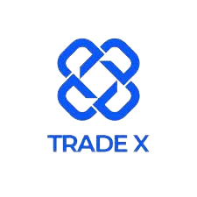
Go-to-Market Strategy
TEAM DTAI
Notes:
• Good evening, everyone. Thank you for your presence. We're diving into a realm where opinions become investments, and TradeX is in this revolutionary journey.

Slide 2

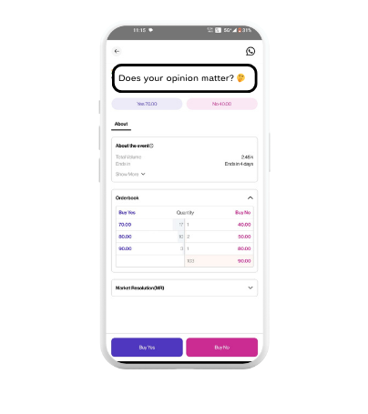
Does your opinion matter?
YES
NO
LINK
Notes:
• Now, as we kick off, let me ask you a question. Does your opinion matter? I believe you have an answer. Do not change it; we’ll get back to you.
• Before we start with our presentation, here’s a small video for you. [Video Plays] Relatable, isn’t it?
• So, let's start with what is TradeX. TradeX is not just an exchange; it's a movement. Whether climate change, transportation, currencies, or launching the latest blockbuster, we empower individuals to trade on their knowledge, not just financial reports. And our unique selling proposition? Eliminating the need to dissect company financials or worry about market intricacies, TradeX is making opinions investable.

Slide 3

Agenda
Objectives & Goals
User Base & Persona
Key Performing Indicators
Target Market
Acquisition Strategies
OEM & Projections
Competitive Analysis
Recommended Technologies
Executive Summary
Notes:
• What’s in this PPT for you? Alright, let's set the stage. Today's presentation is not just about information; it's about taking you on a journey, unveiling the roadmap for TradeX's next chapter. So, let's break down what we're diving into.
• Finally, as we wrap up, we'll walk you through the execution summary. This is where the rubber meets the road, and our visionary plans become actionable steps. It's not just about strategy; it's about making things happen. Let's dive in!

Slide 4
Goals
Marketing Goal
Product Goal
Revenue Goal
Achieve 100% organic user growth MoM and community-driven referral program
Onboard 100,000 new users in the first year
Reach $5 million in transaction volume by end of year 1
Notes:
Goal Let's talk about the heart of our mission – the goals that will propel TradeX. Here are the key goals that will be our guiding stars:
• First, our Marketing Goal is about organic growth and community-driven referrals. We're not just aiming for growth; we're aiming for 100% organic user growth month over month. Imagine TradeX becoming the buzz, spreading like wildfire. And our community-driven referral program? It's not just a program; it's a movement. We're turning users into advocates, making TradeX the talk of the town.
• Next on the list is our Product Goal – a bold one. We're not just talking about users but about onboarding 100,000 new users in the first year alone. It's not just a number; it's a testament to the irresistible pull of TradeX.
• And finally, the Revenue Goal. Picture this: TradeX generating a transaction volume of $5 million by the end of the first year. It's not just a monetary milestone; it's a testament to the value we're bringing to the table. We're not just trading but creating an economic force to be reckoned with.
• Rather than competing, TradeX can redefine the game. The goals are not just targets; they're the fuel that will propel TradeX to unprecedented heights.

Slide 5

Target Market & User Persona
(Analysis based on available information and potential interpretations)
Individuals comfortable with digital platforms, financial concepts, and potentially with an interest in specific event types
Fun fact? Prediction market user check portfolios 4x more frequently when they have money riding on major sporting events.
Willingness to risk personal capital based on predictions and market fluctuations.
Notes:
• We've set ambitious goals, and now, it's time to explore the audience that will embrace and thrive in our dynamic environment.
• Our ideal users are those who dance effortlessly with digital platforms and are comfortable with the flow of financial concepts. We're not just talking about traders; we're talking about individuals who find joy in the predictive dance of market fluctuations. These are the enthusiasts who not only understand the pulse of digital platforms but revel in the excitement of turning predictions into investments.
• And here's where it gets interesting. We're not just looking for spectators; we're searching for those willing to take a plunge, to risk their capital based on their predictions. It's not just about understanding the game; it's about being an active player, ready to ride the waves of the market.
• Here's a fun fact that adds a dash of intrigue to our analysis. Kalshi’s research says that prediction market users check their portfolios four times more frequently when money is riding on major sporting events. It's not just about the financial stakes; it's about the thrill, the engagement, and the dynamic energy that comes with having skin in the game.
• The objective is to curate a community of passionate, engaged individuals ready to make predictions, take risks, and turn opinions into investments.

Slide 6

Sanket
Job title | Student
Location | India
Company size | N.A.
Education | Undergraduate/graduate
Acquisition channels | Discord Server
Goal | Entertainment, test knowledge on various topics, and potentially win small rewards
Frustration | Complex market dynamics, difficulty understanding underlying data, lack of educational resources for beginners
Age: 20-30
Casual Speculator
Notes:
• User Persona Now, as we embark on the journey to understand our user base more intimately, let's shift our focus from the competitive landscape to the heart of TradeX – the personas that breathe life into our platform. We're not just analysing numbers; we're getting to know the individuals who will shape the TradeX experience.
• Picture this: We've categorised our users into three vibrant personas, each represented by a distinct individual. Let's meet them:
• First, meet Sanket, a 21-year-old student and casual observer from India and currently pursuing undergraduate or graduate studies. He first learned about TradeX through a Discord Server. Sanket’s goal? Sanket aims to have fun, test his knowledge on various topics, and potentially win small rewards using TradeX. The frustration? Sanket's frustration stems from the complex market dynamics, difficulty in accessing underlying data, and a lack of educational resources for beginners.

Slide 7
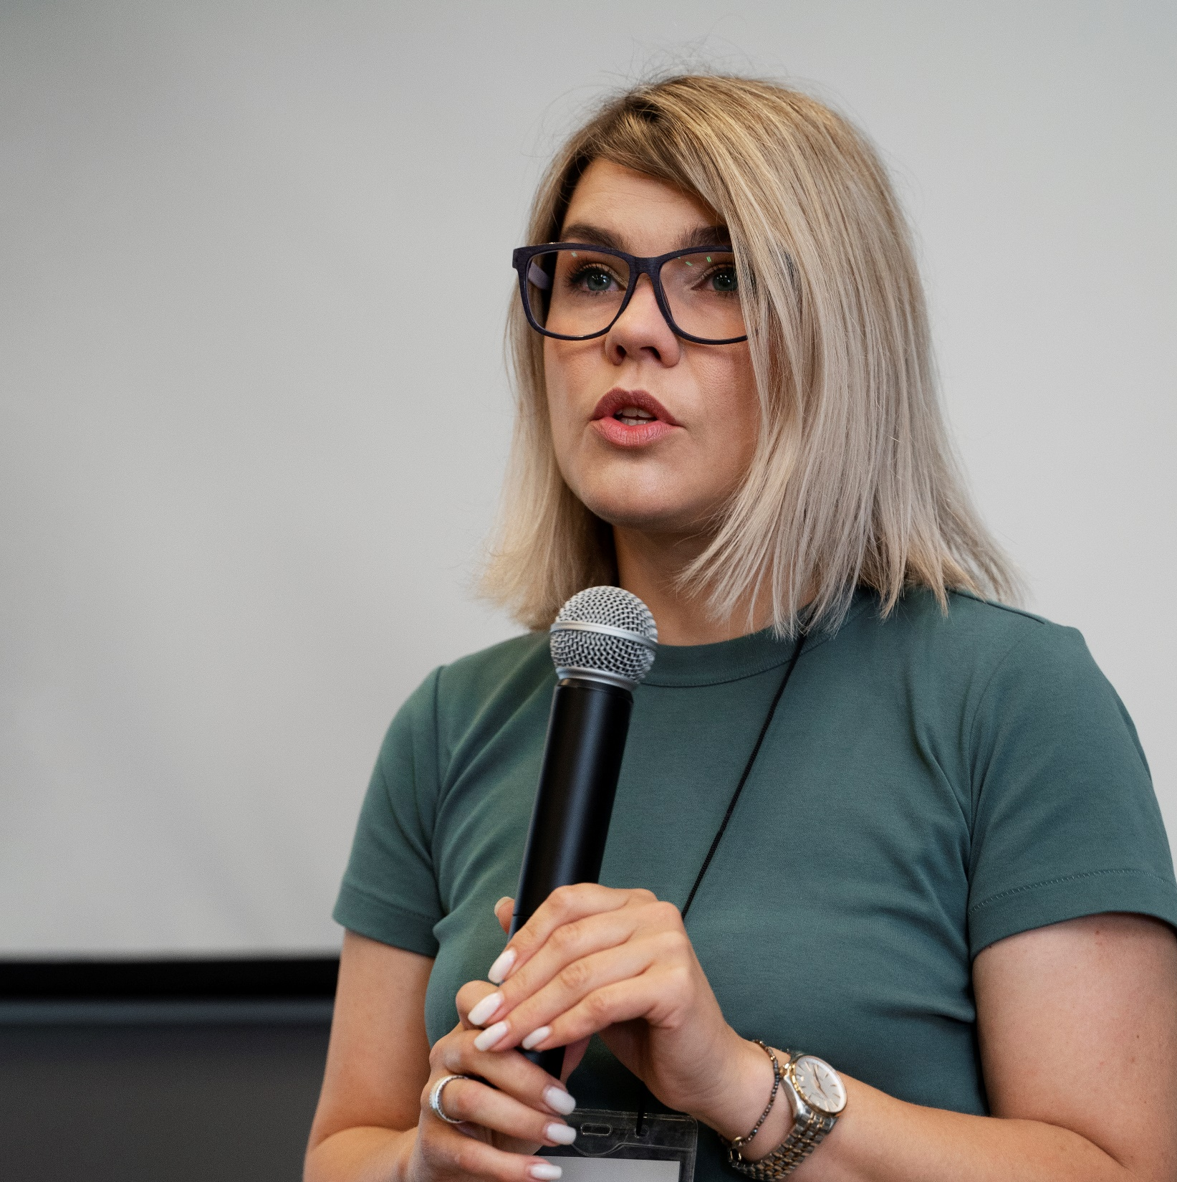
Anne
Job title | Senior Journalist
Location | Canada
Company size | 200
Industry | Media
Acquisition channels | Business Affairs
Goal | Willing to speculate on political outcomes but prioritizes reliable information and analysis
Frustration | Limited markets on specific geopolitical events, potential for bias and misinformation, lack of transparency in market dynamics
Age: 30-40
Geopolitical Analyst
Notes:
• Next, we have Anne, age 32, a resident of Canada, who holds the position of senior journalist and geopolitical analyst in a media company with 200 employees. She became acquainted with TradeX through the Business Affairs Newspaper. Anne’s goal is to forecast political outcomes but gives precedence to trustworthy information and analysis. The frustration? She is frustrated as few markets are available for specific geopolitical events, and there is a potential for bias, misinformation, and a lack of transparency in market dynamics.

Slide 8

Syed
Job title | Quantitative Analyst
Location | Bangladesh
Company size | 100
Industry | Tech/IT
Acquisition channels | Social Media
Goal | Generate alpha returns, exploit market inefficiencies, and identify undervalued predictions
Frustration | Lack of advanced order types, limited tools for algorithmic trading, potential for market manipulation by sophisticated bots
Age: 25-35
Data-Driven Trader
Notes:
• And then, there's Syed, who is 27, a Quantitative Analyst and Data-driven trader who resides in Bangladesh and is employed in a tech/IT company with 100 employees. He became acquainted with TradeX through social media. Syed aims to achieve alpha returns, capitalise on market inefficiencies, and identify undervalued predictions.. His frustration? Sanket's frustration with TradeX is due to the need for advanced order types, limited tools for algorithmic trading, and the potential for market manipulation by sophisticated bots.
• These personas aren't just characters on paper; they're the heartbeat of TradeX. The goal should not be just creating a platform but curating an experience that resonates with individuals from all walks of life. These personas make TradeX more than just a trading platform.

Slide 9



Competitive Analysis
Polymarket
Kalshi
Probo
A decentralized prediction market built on the Ethereum blockchain, focusing on political and economic events.
A prediction market platform specializing in financial markets and business outcomes.
An Indian prediction market platform focusing on a diverse range of events, including cricket, politics, entertainment, and even weather.
Competitive Advantages:
Security
Global Reach
Transparency
Competitive Advantages:
Institutional Focus
Regulatory Compliance
Focus on Real-World Assets
Competitive Advantages:
Localized Focus
Loyalty Programs
User-Friendly Interface
Notes:
• Competitive Analysis (Khare)
• Now that we've got a glimpse into the dynamics of our target market and users, it's time to shift our focus to the competitive landscape. In this realm of prediction markets, we stand shoulder-to-shoulder with some formidable players, each with unique strengths and advantages.
• Meet our contenders:
• First, we have Polymarket, a decentralised prediction market leveraging the power of the Ethereum blockchain. Their focus? Political and economic events. Their competitive edge lies in security, global reach, and transparency. It's not just a platform; it's a fortress of predictability.
• Next in the ring is Kalshi, a specialised prediction market platform honing in on financial markets and business outcomes. What sets them apart? An institutional focus, regulatory compliance, and a keen eye on real-world assets. They're not just predicting; they're navigating the intricate dance of global finance.
• And then, we have Probo, the Indian prediction market powerhouse. Their forte? A diverse range of events, from cricket to politics and entertainment. Their secret sauce? A localised focus, a user-friendly interface, and loyalty programs keep users returning for more. It's not just a prediction game; it's an immersive experience.

Slide 10
Acquisition: Now vs Post-Launch
What will we focus on post-launch?
Build virality into the product
Make referrals part of the product and encourage word of mouth
Drive acquisition through SEO
compete in the online marketplace through increased visibility, organic traffic, and enhanced user experience
Leverage online communities
Expand the community team and acquire and engage users via a Reddit, Telegram, Discord etc.
Notes:
• Acquisition: Now and Post-Launch Let's talk about the engine that powers our user acquisition strategies. Currently, we've got four significant channels propelling users to our website. As we look to the competitive landscape, it's evident that our competitors are tapping into three additional acquisition channels. Now, it's not just about numbers; it's about how strategically we can leverage these channels to fuel TradeX's ascent.
• So, what's the game plan?

Slide 11


Acquisition Strategy
Channel | Description
Referrals | Word of mouth, referral programs
SEO | Creating content around relevant product keywords
Communities | Telegram, Discord, Reddit
Partners | Integrations, co-marketing
Email | Welcome and onboarding emails
Social media | Twitter, Instagram, LinkedIn
Notes:
• Our channels encompass referrals, SEO, communities, partners, social media and email – each a powerhouse in its own right. Referrals go beyond marketing; they're the heartbeat of word-of-mouth growth. SEO is our digital calling card, ensuring that TradeX is discovered by those searching for the predictive revolution. Communities bring a sense of belonging and engagement, fostering a vibrant ecosystem. And email, well, it's not just about onboarding but building relationships.
• Now, post-launch, we're not just resting on our laurels but cranking it up a notch. We're weaving virality into the product, making referrals an integral part of the TradeX experience. Imagine users not just trading but actively bringing in their peers. We're not just acquiring; we're spreading like wildfire.
• SEO takes centre stage as we strategically create content around relevant product keywords. It's not just about being found; it's about being the first choice in the digital landscape.
• And then, the power of online communities leaps. We're expanding our community team, amplifying our presence on platforms like Discord, Telegram, and Reddit. It's not just about trading; it's about building a movement.

Slide 12
Recommended Technologies
Widget: Slack
Messaging app for teams that makes working together simple and efficient.
Analytics and Tracking: Hubspot
Hubspot provides marketing information and leads via inbounding marketing
Content Management System: Clevertap
Customer relationship management (CRM) platforms
Notes:
• Recommended Technologies(Suraj)
• Now that we've delved into the strategies that will skyrocket TradeX let's talk about the gears that will power this rocket. As we navigate the dynamic landscape of user acquisition, we must integrate the right technologies into our workflow. Let me walk you through some key recommendations to streamline and supercharge our operations.
• First on the list are Slack widgets. Think of it as our mission control. Slack is not just a messaging app; it's the lifeline that makes collaboration simple and efficient for teams. It's about staying connected, informed, and agile as we propel TradeX to new heights.
• Now, let's talk analytics and tracking. Here, I recommend HubSpot, the powerhouse of inbound marketing software. It's not just about leads; it's about insights that will guide our marketing strategies. And to elevate our digital game, Google Optimize 360 is the go-to. We're not just testing variations; we're tailoring the TradeX experience for each customer, creating a personalised journey that resonates.
• Enter Klaviyo, our maestro for Customer Lifecycle Management. It's not just about managing; it's about orchestrating the entire lifecycle. It's about turning users into lifelong advocates.
• And when it comes to Content Management Systems, I present two formidable options: My Salesforce and Clevertap. Each is a heavyweight in customer relationship management (CRM) with unique strengths and capabilities.

Slide 13

Key Performance Indicators
KPI
KPI
KPI
1
2
3
Marketing KPIs
Product KPIs
Revenue KPIs
Daily website visits
Daily signups
DAUs/MAUs
Avg transactions per user
Retention rate
User-to-customer conversion rate
LTV
Notes:
• KPIs We've laid out the strategies and explored the personas, and now, it's time to dive into the metrics that will measure our success and illuminate the path forward.
• Let's dive into the first set of Key Performance Indicators - our Marketing KPIs. Now, these are the heartbeat of our strategy, giving us a pulse on how well we're connecting with our audience. Daily website visits are our front door. We want it bustling with activity, as every click represents a potential trader eager to invest in their opinions. Daily signups are our lifeblood - the more, the merrier! And DAUs/MAUs? Well, that's the essence of engagement, and we're aiming for nothing short of an electrifying dance of daily and monthly active users.
• Now, onto our Product KPIs. This is where the magic happens. Average transactions per user are our indicator of involvement. We want our traders to participate actively, making bets and taking home wins. Retention rate, folks, is our golden ticket. We're not just about one-off trades; we're building a community. The longer our users stick around, the stronger our foundation becomes.
• And finally, the Revenue KPIs - the sweet sound of success. The user-to-customer conversion rate is where the rubber meets the road. We're not just here for casual observers; we want committed investors. Last but certainly not least is LTV or lifetime value. This is where we measure the enduring impact of our platform on our users' lives.
• TradeX is not just a platform; it's a movement. We are transforming opinions into investments, and our KPIs are the compass guiding us on this exhilarating journey. Remember our motto: What do you do with your opinion? Believe in it. Let's take TradeX to new heights together!

Slide 14

OEMs
Mobile phone manufacturers
Gaming console companies
PC/Laptop OEMs
Pre-load the TradeX app on specific phone models
Pre-install TradeX software on their computers
TradeX available for download on their app stores
Notes:
• OEM Channels (Puru)
• So, without giving too much away, let's dive into the exciting realm of OEM partnerships and how they tie into our pulse-quickening KPIs.
• Now, while we're not dealing with physical hardware, our software can still find its way into the hearts and screens of users through strategic partnerships. Imagine having TradeX at your fingertips, seamlessly integrated into the devices you use every day!
• First up, mobile phone manufacturers. Picture this: the TradeX app is pre-loaded on specific phone models, making trading on life's outcomes as easy as checking your messages. PC and laptop OEMs could offer TradeX as pre-installed software, making every computer a gateway to the derivative trading revolution. And let's remember gaming console companies, where TradeX becomes a downloadable gem in their app stores, ready for gamers to explore between rounds.
• Securing these OEM channel partnerships is a challenge in the park. We're talking about adapting our platform to fit seamlessly into these devices, providing additional localisations, languages, and more. Of course, sweetening the deal with revenue share, licensing fees, or other juicy incentives to the OEM is key. It's an investment in custom integration and co-marketing efforts that will set TradeX apart in these channels.
• But here's the real kicker – our strategy. We're laser-focused on achieving minimal Customer Acquisition Cost (CAC), Cost Per Install (CPI), and Cost Per Mille (CPM). How? By unleashing the power of virality and a replicable growth playbook. We want TradeX to spread like wildfire, and we will make it happen.
• Think about it - users love the platform, sharing their trading wins with friends, and those friends want in on the action. That's virality. And the growth playbook? It's all about identifying what works, documenting it, and then rinsing and repeating it. We're not reinventing the wheel but optimising it for maximum impact.

Slide 15
Executive Summary
Minimal motivation for user referrals & sharing
Effective influencer marketing
Community feel and engagement
Differentiated positioning & messaging
SEO and discovery
Technical optimization of site architecture and content strategy focused on prediction-related keywords and topics
Build authentic relationships with nano/micro-influencers aligned to niche interests
Implement referral program mechanics with rewards, gamification and social recognition for brand advocates
Foster user interactions through forums, content, competitions and social features in the product experience
Highlight unique features, transparency, and community in inbound outreach.
Notes:
• Execution Summary
• Let's dive into the core of our strategy – solving critical problems to propel TradeX into a league of its own. Now, every challenge is an opportunity in disguise, and we've got some exciting solutions that will set the stage on fire. Buckle up because we're about to turn obstacles into triumphs!
• First on the list: Poor website SEO and discovery. Our solution? Think of it as giving TradeX a turbo boost in the digital race. We're talking technical optimisation, a strategic overhaul of our site architecture, and a content strategy that aligns seamlessly with prediction-related keywords and topics. We're not just upgrading; we're revolutionising our online presence.
• Next up: Ineffective influencer marketing spending. Say goodbye to wasted resources. We're shifting gears, building authentic relationships with nano and micro-influencers who resonate with specific niche interests. It's not about the numbers; it's about genuine connections that speak directly to our audience.
• Now, let's talk about user referrals and sharing. We're not just asking; we're inspiring action. Our referral program is getting a serious makeover. Think rewards, gamification, and social recognition. We're turning users into advocates, sparking organic promotion without the need for direct incentives. It's not just about trading; it's about building a movement.
• Moving on to the lack of community feel and engagement. Brace yourselves for a transformation. Forums, competitions, social features – we're creating an ecosystem where users don't just trade; they connect, compete, and collaborate. TradeX isn't just a platform; it's a thriving community.
• Finally, there is a need for differentiated positioning and messaging. We're putting our unique features in the spotlight. Blockchain, transparency, community – these aren't just buzzwords. They're the pillars that make TradeX stand tall. Our marketing outreach is about to scream innovation and authenticity.
• These solutions are not just fixes; they're elevations. We're not just solving problems; we're paving the way for TradeX to redefine the game.
• Closing Statement
• We've identified challenges, unleashed innovative solutions, and set the stage for a monumental shift. TradeX isn't just a platform; it's a movement. It is a movement where opinions become investments, challenges become opportunities, and every user is not just a trader but a part of a vibrant community.
• TradeX isn't just shaping the future; it's defining it. Thank you for being part of this presentation. That’s team DTAI signing off. Thank You again.

Slide 16
THANK YOU!!
- TEAM DTAI
IIT KGP

